Slide 1

IPL Analysis(2021-2023)
Power BI Project

Slide 2
Overview:-
The goal of this Power BI project is to analyze IPL (Indian Premier League) cricket data to gain insights into team and player performance, match outcomes, and various key metrics related to both batting and bowling. The analysis will be carried out using data from multiple related tables, providing a comprehensive view of the tournament's dynamics.

Slide 3
Dataset:-
Dim Match Summary
o Columns Description:
▪ team1: Name of the first team
▪ team2: Name of the second team
▪ winner: Winner of the match
▪ margin: Margin of victory
▪ matchDate: Date of the match
▪ match_id: Unique identifier for the match
Dim Player
o Columns Description:
▪ name: Name of the player
▪ team: Team the player belongs to
▪ battingStyle: Batting style of the player (e.g., Right-hand bat)
▪ bowlingStyle: Bowling style of the player (e.g., Right-arm fast)
▪ playingRole: Role of the player (e.g., Batsman, Bowler)

Slide 4
Fact Batting Summary
o Columns Description:
▪ match_id: Unique identifier for the match
▪ match: Description or name of the match
▪ teamInnings: The team batting in the innings
▪ battingPos: Batting position of the player
▪ batsmanName: Name of the batsman
▪ out/not_out: Whether the batsman was out or not out
▪ runs: Runs scored by the batsman
▪ balls: Balls faced by the batsman
▪ 4s: Number of fours hit
▪ 6s: Number of sixes hit
▪ SR: Strike rate of the batsman
Fact Bowling
o Columns Description:
▪ match_id: Unique identifier for the match
▪ match: Description or name of the match
▪ bowlingTeam: Name of the team that is bowling
▪ bowlerName: Name of the bowler
▪ overs: Number of overs bowled by the bowler
▪ maiden: Number of maiden overs bowled
▪ runs: Runs conceded by the bowler
▪ wickets: Wickets taken by the bowler
▪ economy: Economy rate of the bowler
▪ 0s: Number of dot balls bowled
▪ 4s: Number of fours conceded
▪ 6s: Number of sixes conceded
▪ wides: Number of wide balls bowled
▪ noBalls: Number of no balls bowled

Slide 5
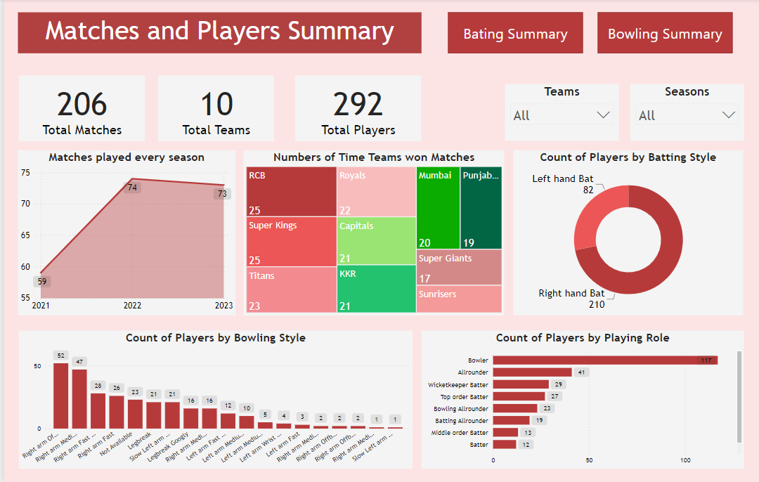
Matches and Players Summary:-
Between 2021 and 2023, the IPL witnessed a highly competitive environment with a total of 206 matches played among 10 participating teams, With a total of 292 players participating across these three seasons.
RCB Dominated with the highest number of wins, showcasing consistent performance across the seasons.
The majority of players in the IPL are right-handed batsmen and The most common bowling style observed is Right-arm Offbreak.

Slide 6
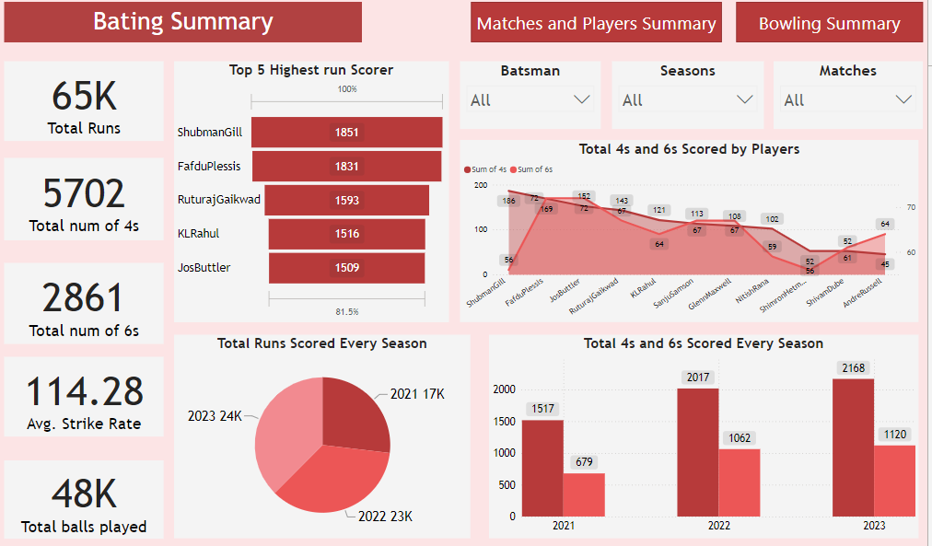
Bating Summary:-
Shubman Gill is the highest run-scorer across the three seasons, amassing 1851 runs followed by Faf du Plessis.
When it comes to hitting sixes, Jos Buttler and Faf du Plessis lead the charts.
Shubman Gill stands out as the top scorer of fours during the analyzed seasons.

Slide 7
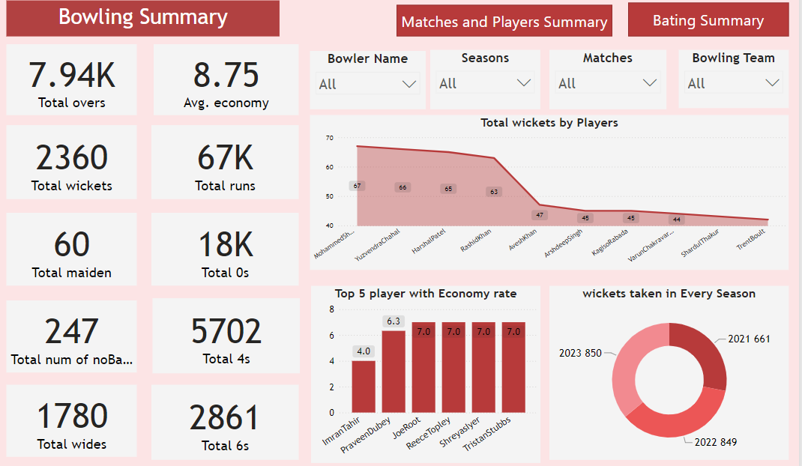
Bowling Summary:-
In all season combined Mohammed Shami has been highest wicket taker followed by Yuzvendra Chahal and Harshal Patel.
Imran Tahir’s economy rate of 4.00 across the 2021-2023 IPL seasons highlights his exceptional control and effectiveness as a bowler in the T20 format.

Slide 8
Thank You!

